Slide 1
SVMs: Kernel Trick and RBF
By: Siddharth Kaipa

Slide 2
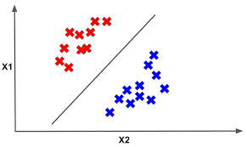
Background on SVM
Support Vector Machine: A supervised classification model
Finds the boundary that maximizes the gap between classes
Support vectors: the closest points to the decision boundary
Uses dot products: w·x + b = 0 (calculates the line)
w is the weights (how much each feature matters), x is the patients features, and b is the bias (shifts the boundary away from 0)
Results in 1 score representing how strongly the patient’s features align with the learned weight
Linear SVM:

Slide 3

What If The Data Isn’t Linearly Separable?
Naive solution:
Imagine each point has one feature - distance from origin (x)
Now add in another feature (x²) - the points now have one more coordinate - plotted on a higher dimensional space
Keep adding features until the data becomes linearly separable

Slide 4
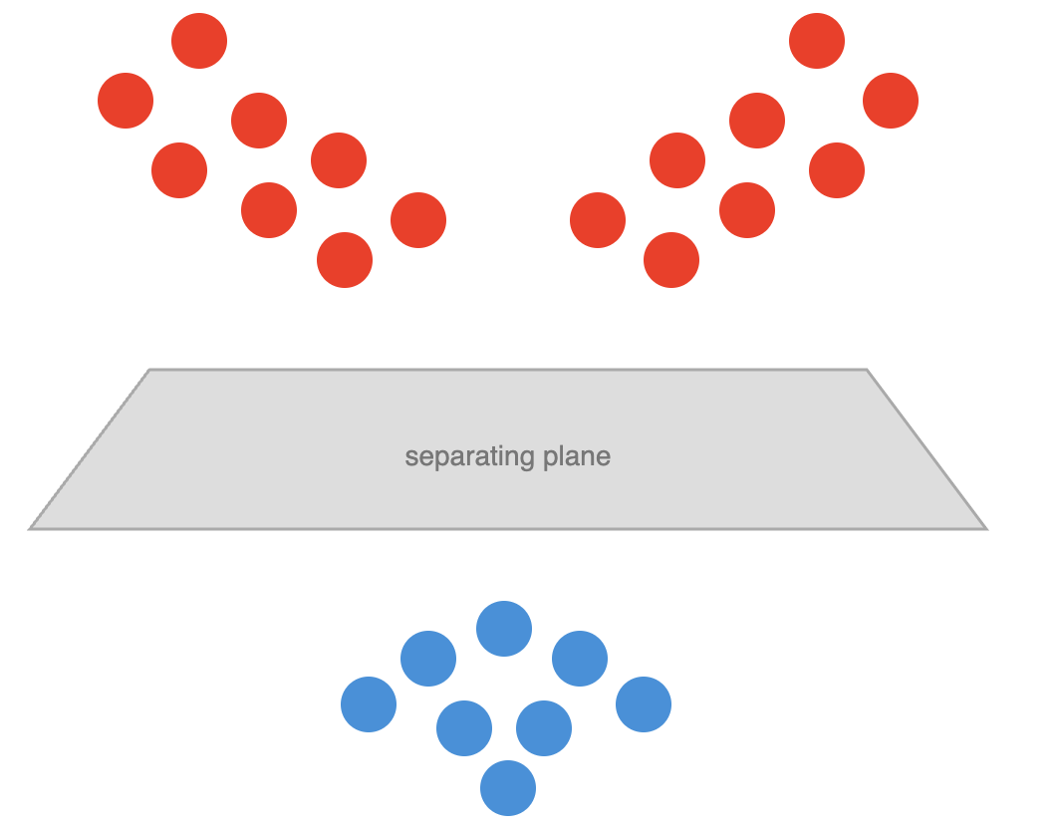
Naive Solution
Problems:
Too computationally heavy
Adding squares, cubes, and interactions between multiple features grows the number of features exponentially
Simple calculations can take a lot of time

Slide 5
The Kernel Trick
A shortcut function that calculates the dot products necessary for an SVM, assuming that the data is in the higher dimensional space
Key: Bypasses the need to physically project the data in a higher dimensional space
Instead of transforming the data and then computing dot products, we can call a kernel k and get the same answer
Exploits the fact that SVM only needs dot products by replacing those calculations with a kernel function

Slide 6
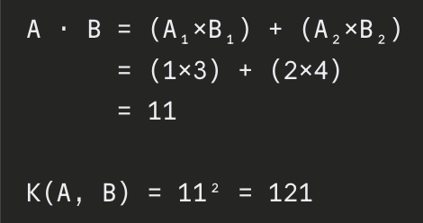
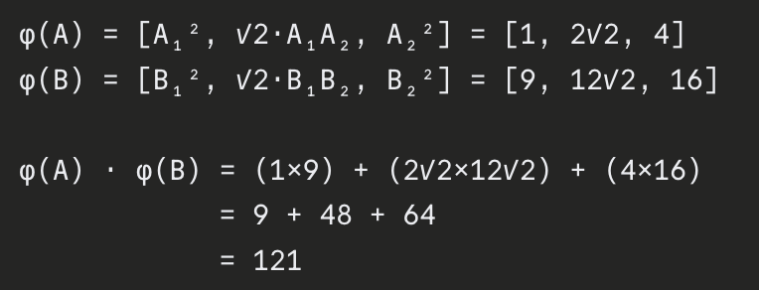
Example - Have 2 points and want to see if they are separable
A = [1, 2]
B = [3, 4]
Option 1: Naive Solution - Create 3 features out of 2
φ([x₁, x₂]) = [x₁², √2·x₁x₂, x₂²] - (These three values represent every possible way to combine two features by multiplying them together, √2 is a scaling factor that makes sure the math works)
Option 2: Use a (polynomial) kernel

Slide 7
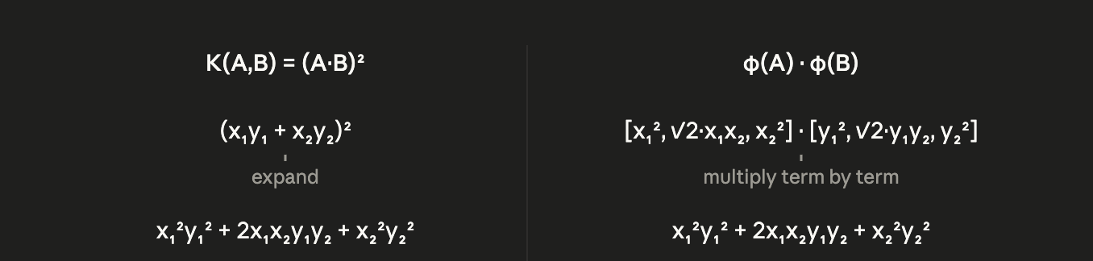
Why They Match

Slide 8
Radial Basis Function (RBF)
Formula: K(A, B) = exp(-γ ||A - B||²)
Using the same points from the example:
A - B = [1-3, 2-4] = [-2, -2]
||A - B||² = (-2)² + (-2)² = 4 + 4 = 8
-γ controls how quickly the similarity between points fades as the distance grows (we’ll choose 0.5). High gamma means only nearly identical points are considered similar, while low gamma means even fairly distant points can still be similar
-γ × 8 = -0.5 × 8 = -4
Final step is to exponentiate
exp(-4) ≈ 0.018
The output is always between 0 and 1, with closer to 0 being more different
A = [1, 2]
B = [3, 4]

Slide 9
Why RBF is Useful
The polynomial kernel we used before mapped 2 features into 3 dimensions by adding terms that are squared. To get more power, simply add in cubed terms, quartic terms, etc.
Higher degree polynomials = higher dimensional space
RBF does all these expansions at once, by using an infinite series
The exponentiation expands into exp(x) = 1 + x + x²/2! + x³/3! + x⁴/4! + …
The RBF equation K(A, B) = exp(-γ||A - B||²) is actually summing up the dot products of all the polynomial spaces at once, meaning that it’s infinite dimensional
In theory, this allows RBF to separate any two groups

Slide 10
Questions?

